Slide 1


Zero Carbon Step
Code: An Introduction
For the Meeting Name Goes Here
Presenter name, title, organization
Month Day, 2023

Slide 2

Today’s Presentation
Buildings and climate change
Overview of the regulation
Compliance options with sample projects
Sample proposed implementations
Notes:
In this presentation, I will walk you through:
The contribution
What the new regulation is, where it comes from, and how it works.
What it seeks to accomplish,
The various compliance options available to builders and developers.
And a hypothetical implementation by a local government.
I’ll also share a handful of examples of various new or recent buildings from around the province that would likely comply with its various levels, and take your questions.
And before we dive in, a disclaimer. This presentation is intended to be a high-level and plain-language introduction to recent revisions to the British Columbia Building Code. The source material is technical, and there are exceptions—and exceptions to the exceptions. It’s intended to as an overview for elected officials, builders, consultants, and service providers. In short, this isn’t legal advice.
Also, we’re using the term local government in here, but the regulation is available to any authority having jurisdiction over the B.C. Building Code.

Slide 3

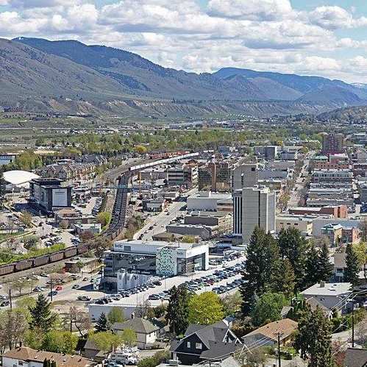
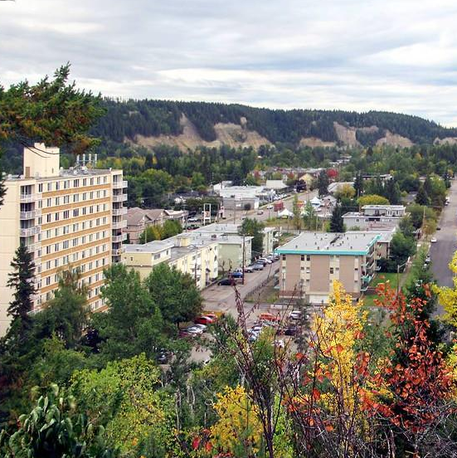
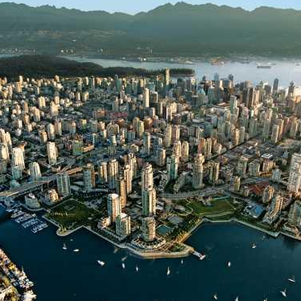




Fossil fuels in buildings drive climate change
Relative share of overall carbon pollution produced by natural gas, fuel oil, and propane burned in buildings.
29%
City of Kamloops
57%
City of Vancouver
12%
British
Columbia
38%
City of
Prince George
Notes:
The day-to-day operation of buildings contributes about 12 per cent of British Columbia’s overall greenhouse gas emissions.
However, when we take stock of emissions at the community scale, buildings become either the number one or two source of carbon pollution. For example:
In the City of Kamloops, buildings constitute 29 percent of all community carbon pollution.
In the City of Prince George, they represent 38 percent of all emissions.
And in the City of Vancouver, buildings produce 57 percent of the community’s emissions.
Many, if not all, British Columbia local governments have their own climate change targets and climate action plans.
But, until recently, they have had a limited number of policy tools available to them to reduce emissions.
Considering these numbers, it’s clear that local governments will be challenged to meet their climate objectives without policy tools that target emissions from buildings.
Sources:
Provincial Inventory of Greenhouse Gas Emissions 1990-2020, Province of British Columbia.
City of Prince George. 2020 Climate Change Mitigation Plan. https://www.princegeorge.ca/media/134
City of Kamloops. "Community Climate Action Plan. June 2021. https://www.kamloops.ca/our-community/environment-sustainability/climate-action
City of Vancouver. Climate Emergency Action Plan. 2022.

Slide 4




Top residential carbon pollution sources
Fossil fuel space and water heating equipment contributes the majority of household carbon pollution.
64%
Space heating
35%
Water heating
1%
Cooking
Notes:
So, where do the greenhouse gas emissions from buildings originate?
Fossil fuel space and water heating equipment produce the majority of climate pollution in buildings; appliances and lighting play a smaller role.
In homes, natural gas space and water heating contribute 98.6 percent of average household emissions. The numbers are similar with commercial buildings.
Just shy of one million British Columbia households currently subscribe to natural gas service, which is used for space and water heating, and cooking.
In British Columbia, the average single family detached home emits about 4.9 tonnes of CO2e per year.
In communities beyond the reach of the natural gas distribution system, many British Columbians use propane, another fossil fuel.
While both the province and many communities have set targets to reduce carbon pollution, building emissions across British Columbia increased 1.2 percent between 2019 and 2020—the most recent year tracked.
Sources:
Annual Information Form, Year Ended December 31, 2021,” FortisBC, March 18, 2022.
The Office of Energy Efficiency at Natural Resources Canada (NRCan). National Energy Use Database (NEUD), 2019 Data. "Residential Sector British Columbia, Table 2: Secondary Energy Use and GHG Emissions by End-Use" and “Commercial/Institutional Sector - British Columbia and Territories - Table 2: Secondary Energy Use and GHG Emissions by End Use.”
Robyn: I think you may need a slide explaining why electrification is such an important global decarb strategy. You could talk about other electricity grids working to decarb, but BC is already almost completely there. Then you could reveal the carbon content of BC electricity - and clean electricity standard that will take it to 100%. This info is important as context for why electric appliances are the way to go

Slide 5
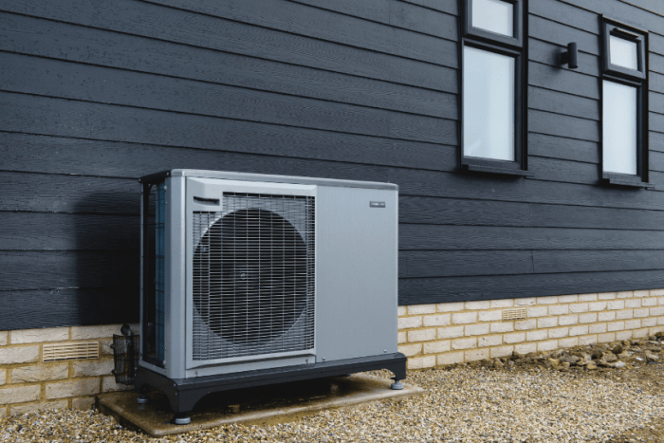
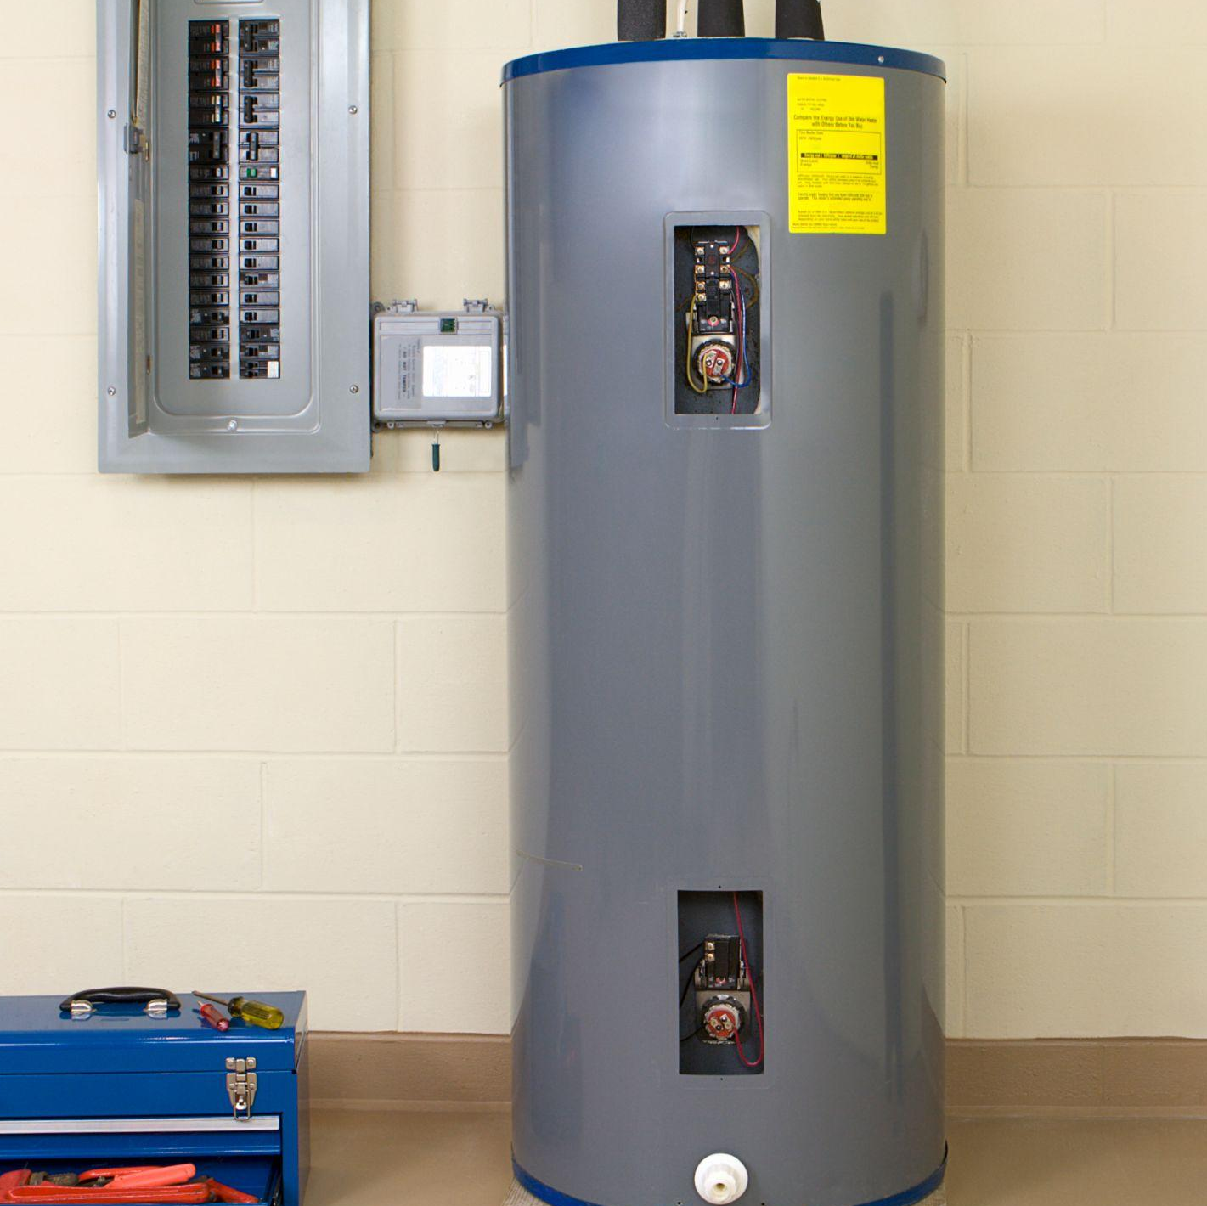
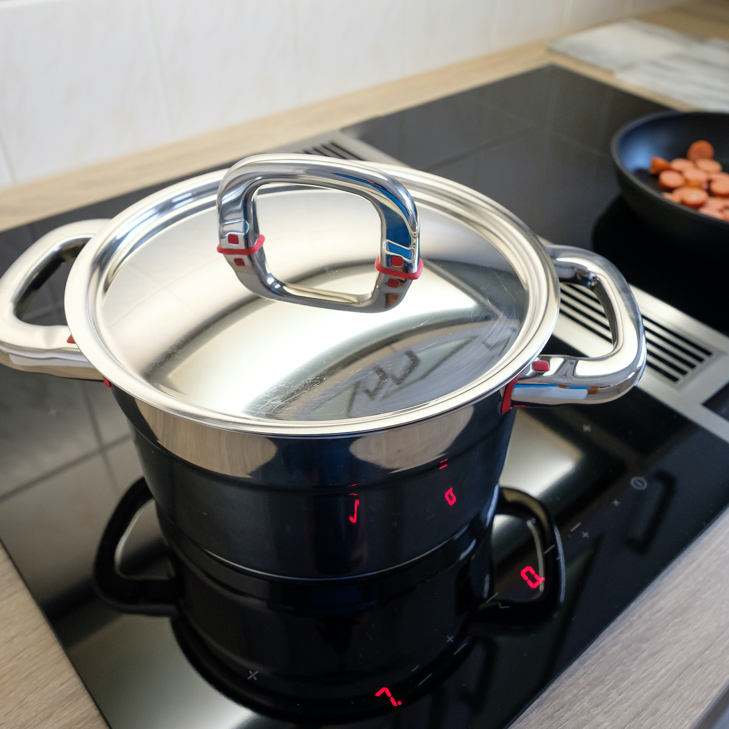

Zero-carbon electric equipment
Electric heat pump
Electric water heater
Induction stove
Notes:
In British Columbia, grid electricity is close to zero emissions; 98 percent of it is generated from clean or renewable resources.
The province has also committed to a 100% Clean Electricity Delivery Standard that will ensure the grid is zero emissions.
A wide selection of efficient electric equipment is now readily available, with technicians and contractors needed to install and service it.
While electric baseboard heaters are still widely used across the province, they are not energy efficient. As a result, many builders are now specifying air-source electric heat pumps.
Electric heat pumps provide cooling in the summers and heat in the winters.
Cold climate heat pumps are built to work efficiently in conditions down to -25 degrees Celsius, with some systems maintaining an efficiency of over 200 percent at -18 degrees Celsius.
Further, electric induction cooktops are quickly gaining popularity in the marketplace, and efficient electric water heaters are also readily available.
Sources:
Cold-climate air source heat pumps: assessing cost-effectiveness, energy savings and greenhouse gas emission reductions in Canadian homes; Ferguson, A; Sager, J. 2022, 36 pages. https://www.nrcan.gc.ca/maps-tools-and-publications/publications/energy-publications/publications/cold-climate-air-source-heat-pumps-assessing-cost-effectiveness-energy-savings-and-gr/24208
“What is a cold climate heat pump?” Province of British Columbia, Better Homes BC, https://www.betterhomesbc.ca/products/what-is-a-cold-climate-heat-pump/

Slide 6
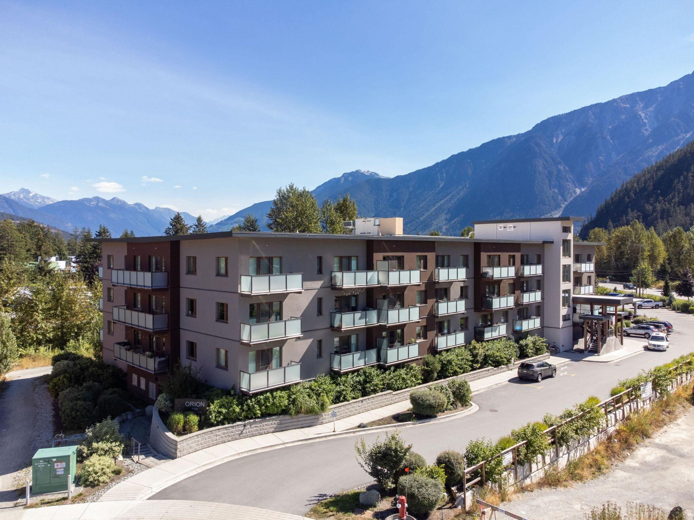
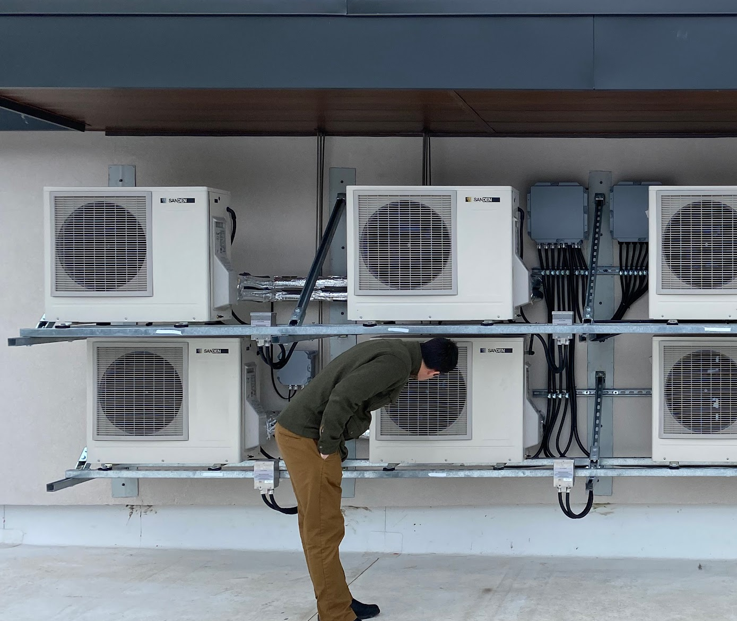
Courtesy Innovation Building Group
Zero carbon energy systems - MURBs
Notes:
Zero or low carbon building energy systems are also available for larger commercial, institutional, or residential buildings.
This is a 45-unit, three-storey condo development in Pemberton, B.C., occupied in March 2020.
The developer supplied domestic hot water heating for the suites with the eight air-to-water electric heat pumps shown here. The technician in the image is bending over because he is trying to hear the heat pumps. They are so quiet they can only be heard when you are right in front of them.
This project was built as a high performance building for less than it would have cost to build a code minimum building.
Sources:
“ZEBx Case Study: Orion – Real-Life Performance of a Step 4, All-Electric Building.” November 2022. https://www.zebx.org/case-study-orion-real-life-performance-of-a-step-4-all-electric-building/

Slide 7
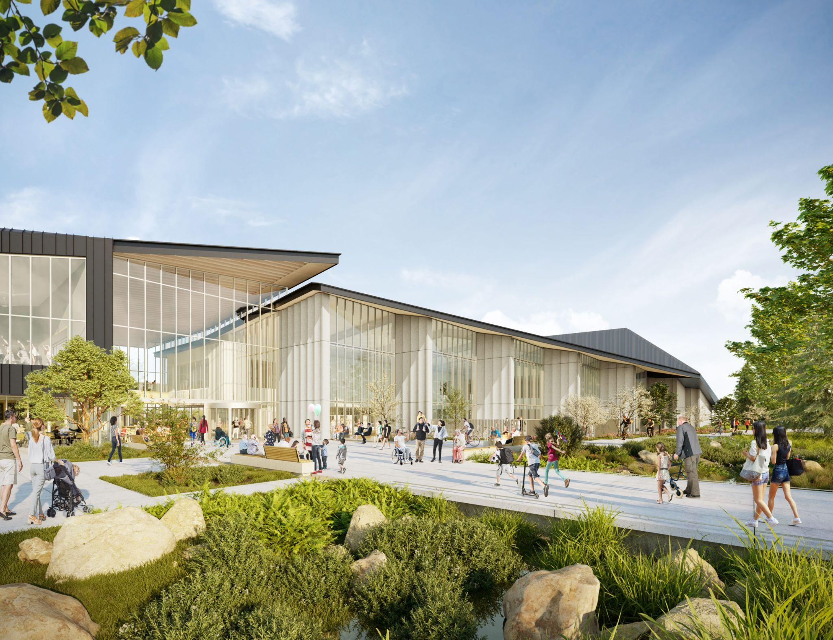
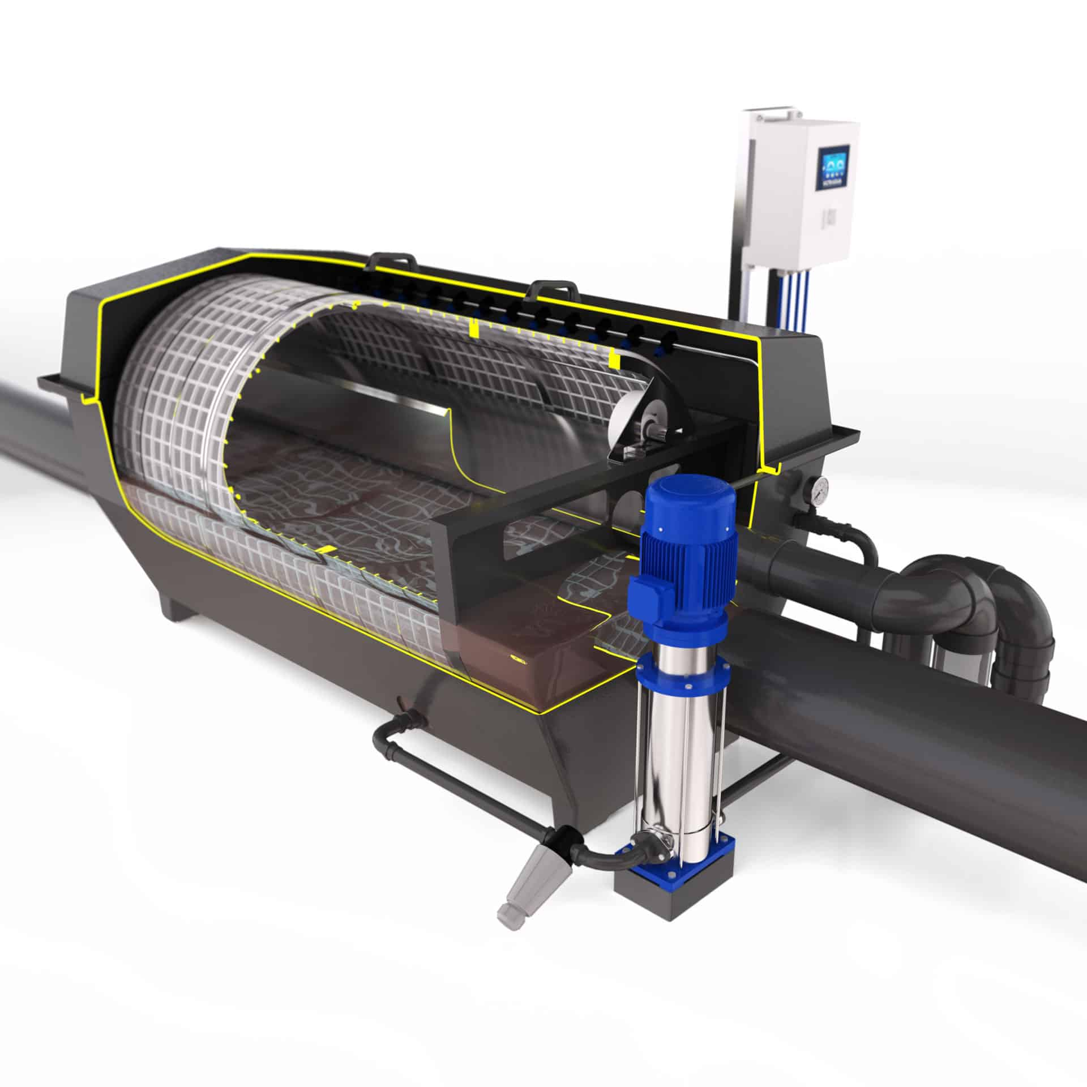
Courtesy HCMA, inBlue / ULTRAAQUA group
Zero carbon energy systems - Civic facilities
Gravity-fed filtration system dramatically reduces energy use
Notes:
Local governments are also showing leadership on zero-emissions low-energy buildings—even with civic facilities that historically have relied heavily on fossil fuels.
This is the təməsew̓txʷ Aquatic and Community Centre which is under construction in the City of New Westminster. [Pronunciation help here.]
This is an example of a building where water heating is a major energy requirement.
This facility will heat pool water with primarily zero-emissions all electric heat pumps.
A rooftop solar photovoltaic array will supply 5% of the building’s total electricity, reducing demand on the grid.
The project team also selected highly energy efficient equipment, such as the Danish filtration technology shown here, the first installation in North America.
It is one contributing element to a low-energy mechanicals system, specific to the needs of the aquatics system.

Slide 8
Notes:
This brings us to the new regulation we are discussing today: The Zero Carbon Step Code
This is a new section of the British Columbia Building Code that local governments may use, if they wish, to regulate the greenhouse gas pollution produced by new buildings.
There are three important points I want to clarify off the top:
First, The Zero Carbon Step Code is not a part of the existing BC Energy Step Code. You can think of it as a sibling regulation. While the BC Energy Step Code addresses the energy-efficiency performance of new buildings, this new Zero Carbon Step Code targets their carbon performance. They both sit side by side within the BC Building Code but are two separate regulations, and a local government may use either, or both.
Second, the standard only addresses the emissions produced by buildings during their operation. It does not regulate a building’s embodied emissions, that is, those those generated by building material manufacturing, and transportation, and the carbon pollution that is produced by construction equipment.
And third, while we know that much of a given community’s carbon pollution originates with existing buildings, the Zero Carbon Step Code addresses new buildings only. In this way, it will reduce the number of buildings that will need to be retrofitted down the road.
Builders and developers working in communities that have adopted it will be required to demonstrate compliance with one or more of its levels. Before getting into how that will work, I would like to spend a moment explaining why the government has introduced it.

Slide 9

Origin of the new regulation
“By 2030, all new buildings will be zero carbon, and all new space and water heating equipment will meet the highest standards for efficiency.”
– CleanBC Roadmap to 2030
Notes:
In 2021, the province released its CleanBC Roadmap to 2030 climate plan. It included a commitment that “all new buildings in the province must produce zero greenhouse gas pollution from their operations by 2030.”
The province also established interim dates for mandatory carbon limits which we will cover later in this presentation.
In 2023, the Province of British Columbia entered the Zero Carbon Step Code into regulation as the pathway to get there.
Local governments may now reference the Zero Carbon Step Code in their building bylaws, if they wish.
It offers them a new tool to help them reach their climate objectives, and by extension, help the province meet its own greenhouse gas targets.
The Zero Carbon Step Code is available to all local governments except the City of Vancouver, which has its own building code and its own plan to reduce carbon from buildings.
This regulation is also optional for local governments, at least for now. In a few minutes, we’ll cover the carbon limits that the province will be introducing in the coming years.

Slide 10

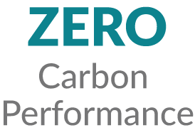

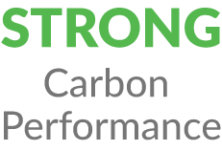




Staggered carbon performance tiers
Notes:
The BC Zero Carbon Step Code is based on varying and measurable performance levels or tiers.
Local governments that choose to reference the Zero Carbon Step Code in their building bylaws can specify the level of climate ambition they want their new buildings to achieve. The regulation staggers climate performance on three levels:
Moderate Carbon Performance,
Strong Carbon Performance, and
Zero Carbon Performance.
The province has also offered local governments a “measure only” option. You will see that at the bottom of the hierarchy.
A community using this option would require its builders to measure and report the amount of carbon pollution that their projects will produce. In many cases, this number is already available on the documentation that builders produce for to apply for a permit, this is just a more formal way to track it.
The province offered this as an information-gathering step, but it will not reduce their emissions.
As we will show in a few minutes, the province is offering local governments the opportunity to mix and match these levels, and also provide various flexible compliance options.

Slide 11


Many types of buildings can be regulated under the Zero Carbon Step Code
Part 9:
Smaller + simpler buildings, specifically…
Part 3:
Larger and more complex buildings, including…
Homes and smaller residential buildings
Offices
Condos + apartments
Financial
institutions
Retail +
grocery stores
Notes:
The province is offering Zero Carbon Step Code metrics for many of the most commonly built building types.
Generally, buildings fall under the two sections of the British Columbia Building Code. Part 9 of the code outlines requirements for smaller and simpler buildings, namely homes. These are residential buildings which are three stories or lower, 600m² or smaller.
Part 3 of the building code addresses larger and more complex buildings, such as those occupancies shown here. These buildings are larger than three stories and/or larger than 600m².
In the next slides, I will walk you through the compliance options, starting with what is available for homes, and then moving on to larger and more complex buildings.

Slide 12
Compliance options and sample projects:
Part 9 homes
Notes:
Again, we’re starting with homes, and then moving on to larger and more complex buildings
I’m also going to show a handful of sample projects around the province and what carbon performance level of they would likely meet based on their characteristics and installed equipment.

Slide 13
Industry compliance: Homebuilders and the performance approach
Quantity of carbon pollution
Intensity of carbon pollution
265
1.5
440
2.5
1,050
Kg CO2e/yr
6
Kg CO2e M²/yr
Maximum GHG emissions per home per year
Maximum GHG intensity per home per year
Notes:
Communities that wish to reference the Zero Carbon Step Code in their building bylaws can require a homebuilder who is applying for a building permit to disclose the anticipated carbon pollution of their proposed project.
There are three ways to do this, and I’m starting here with the first two.
First, they can provide a building official with a calculation of the overall quantity of emissions that their proposed house will produce in a year. In many cases, this information is already in the documentation that a builder will provide to a building official to get their permit. [It is a standard output of a modeling software program that is managed by Natural Resources Canada.]
Second, they can report on the anticipated greenhouse gas intensity of their proposed project. This is a measurement of the total emissions produced over a year divided by the home’s floor area.
Both of these options require using software to calculate how much carbon pollution the home will produce once built and operating, and disclosing that to the building official in advance to confirm compliance.
You may be wondering why the “Zero Carbon” level shown here has a value larger than zero. This reflects the fact that, while our electricity grid is very low emissions, it is not yet zero.
The province has proposed a 100% Clean Electricity Delivery Standard for the BC Hydro grid, and once that’s in place, zero will really mean zero.
Homebuilders also have a third compliance option, known as the prescriptive pathway. I am going to show what that looks like on the next slide.

Slide 14



Industry compliance: Homebuilders and the prescriptive approach
SPACE HEATING
COOKING
WATER HEATING
Zero Emissions Equipment:
Fossil Fuel Equipment:
Notes:
The prescriptive compliance approach means that, instead of asking a homebuilder to run a software simulation to calculate their proposed home’s carbon emissions, the builder can disclose the equipment they intend to install in their proposed project.
Here, we identify the three types of equipment that are assessed under the prescriptive pathway for homes.
Fireplaces and other secondary heating sources are not included in the regulation. A wood fireplace or wood stove, or decorative natural gas fireplace, are excluded.
We’re colour coding them here, the blue versions shown here represent zero-emissions equipment, orange versions represent fossil-fuel burning equipment.

Slide 15
Industry compliance: Homebuilders and the prescriptive approach
No fossil fuels allowed.
Space and water heating and cooking must be zero carbon.
Fossil fuel cooking allowed. Space and water heating systems must be zero carbon.
Fossil fuel water heating
and cooking allowed. Space heating must be zero carbon.
Notes:
The prescriptive compliance approach means that, instead of asking a homebuilder to run a software simulation to calculate their proposed home’s carbon emissions, the builder can disclose the equipment they intend to install in their proposed project.
In a community that requires new homes to meet:
[CLICK TO ADVANCE EACH LEVEL]
…Moderate Carbon Performance, builders can install fossil-fuel cooking and water heating equipment. But the home’s domestic heating system must be zero carbon.
….Strong Carbon Performance, the builder must install zero-carbon space and water heating systems. Fossil fuel based cooking equipment is still allowed at this level.
….Zero Carbon Performance, the builder must ensure that all the home’s equipment — space and water heating, and cooking equipment — is zero emissions.
There are pros and cons for each of these three compliance approaches — carbon quantity, carbon intensity, and the prescriptive path.

Slide 16
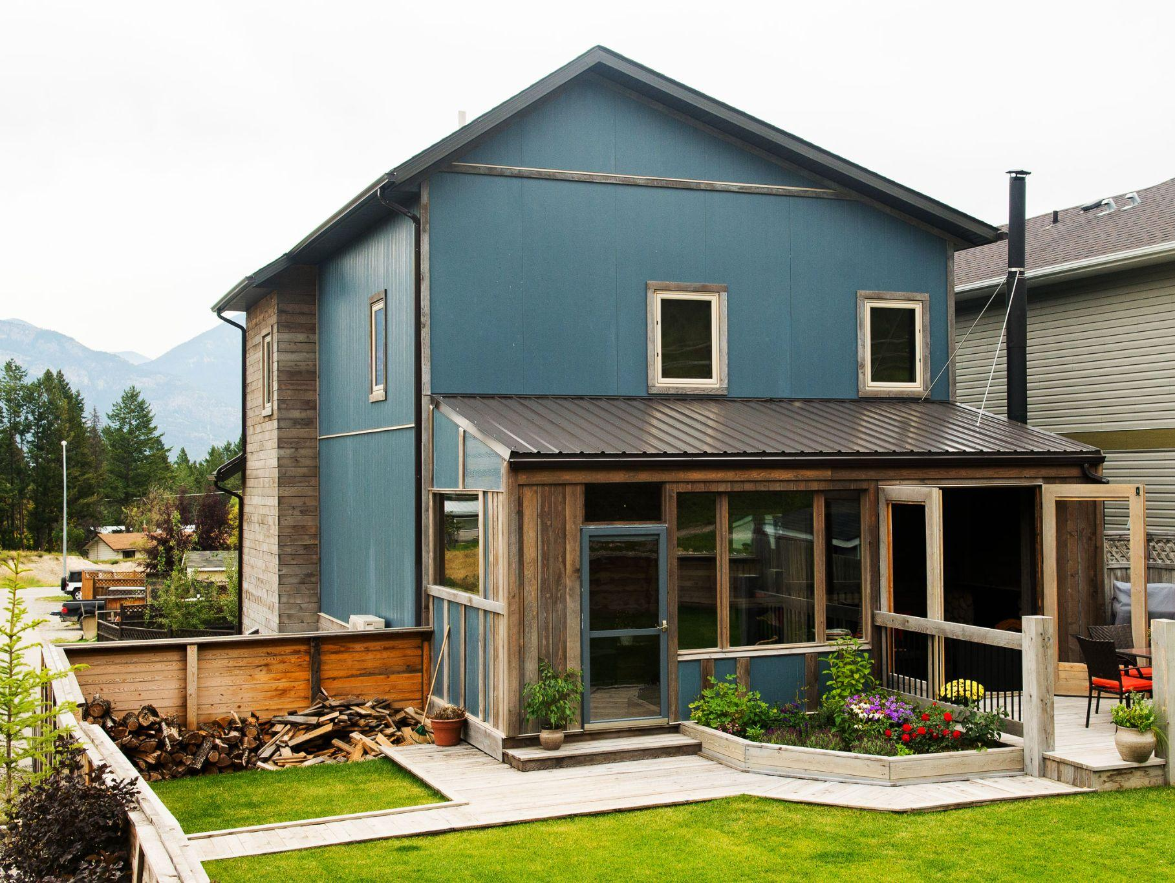
Zero Carbon Performance: Westside Residence, Invermere
Four bedrooms
143 square metres
Climate zone 6
All electric systems:
Air source electric heat pump, conventional electric hot water tank.
Courtesy thinkBright
248
Kg/CO2e/yr
Notes:
This is a four-bedroom family home built in 2018 in Invermere that would meet the requirements of Zero Carbon Performance.
There are no fossil fuel appliances or equipment in this home, and as a result it produces 248 kilograms of CO2e per year—well under the threshold to comply with Zero Carbon Performance.
This home also complies with Step 4 of Part 9 of the BC Energy Step Code. The builder voluntarily built to reach an above-code performance level.

Slide 17
Compliance options and sample projects: Part 3
Larger buildings
Notes:
I will now walk through the compliance options for Part 3 buildings, which are larger and more complex buildings, such as offices, retail and grocery stories, and taller apartment and condo buildings.
And again, we will show a handful of sample projects around the province and what carbon performance level of they would likely meet based on their characteristics and installed equipment.

Slide 18

Industry compliance: Developers and the performance approach
1.5
1.8
3
3
7
kgCO2e M²/year
5
kgCO2e M²/year
Larger Residential
Buildings
Offices
Maximum GHG intensity per building per year
Notes:
There are many types of buildings that fall under Part 3 of the British Columbia Building Code, here are just two examples, and the Zero Carbon Step Code values associated with each.
Note that for Part 3 buildings such as these, only the greenhouse gas intensity intensity (GHGi) metric may be used.

Slide 19
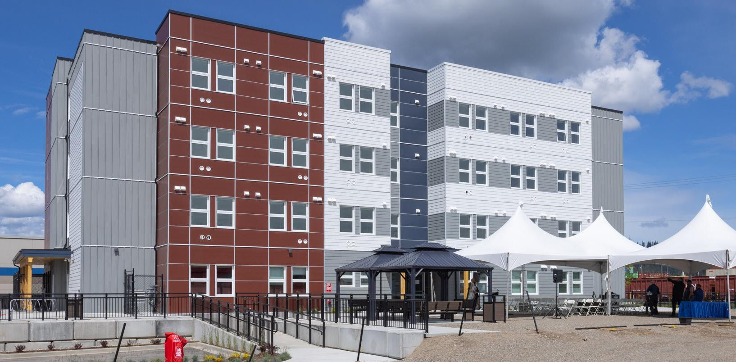
Moderate Carbon Performance: First Avenue Supportive Housing, Prince George
Four stories
48 units
3,037 square metres
Climate zone 6
Natural gas hot water, through-wall electric heat pumps in each unit,
induction cooktops
Courtesy Connective
3.9
kgCO2e M²/year
Notes:
This is a 48-unit supportive housing project in Prince George built by BC Housing and now owned and operated by Connective. It opened in 2022.
The building heats its hot water for residents with a high-efficiency natural gas boiler with 96 percent efficiency.
Individual units are heated and cooled with electric air-source heat pumps. The in-suite kitchenettes have electric induction cooktops.
With a GHGi of 3.9, this building would likely meet the requirements of Moderate Carbon Performance under the Zero Carbon Step Code. It almost meets the requirements of Strong Performance.

Slide 20
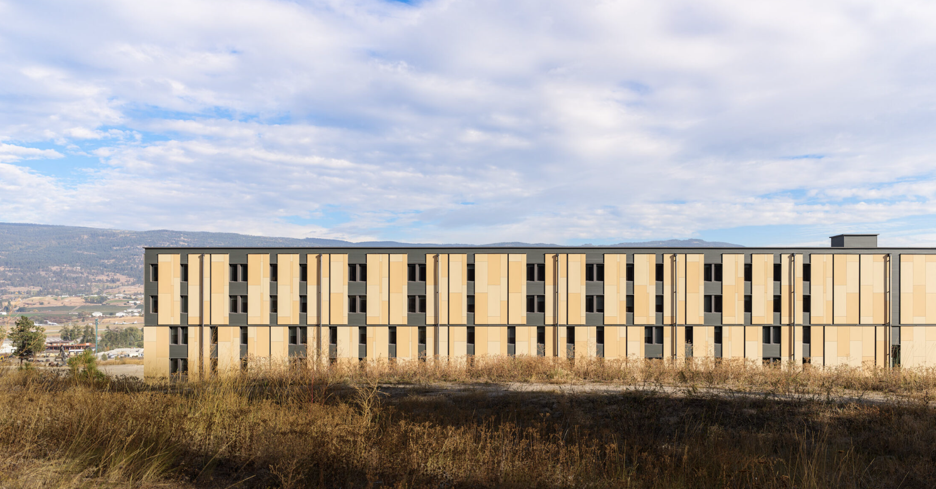
Zero Carbon Performance: UBC Okanagan Skeena student residence, Kelowna
220 units
7,018 square metres
Climate zone 5
All-electric heat, hot water, and cooking.
Courtesy Latreille Architectural Photography
0.66 kg CO2e M²/year
Notes:
This is a student residence at UBC Okanagan campus.
Primary space heating is via an air-to-water heat recovery heat pump with backup electric boiler.
Air-to-water heat pumps provide domestic hot water.
There are no fossil fuel systems in this building, and as a result, it reaches a greenhouse gas intensity of 0.66, or Zero Carbon Performance.
Skeena was designed to target the Passive House certification, and so it also complies with Step 4 of the BC Energy Step Code, the highest step for Part 3 larger and more complex buildings.
PHOTO SOURCE: https://www.andrewlatreille.com/portfolio/skeena-house-ubco-public/ - PERMISSION SECURED
Data source: https://www.zebx.org/wp-content/uploads/2021/02/Final-Version-Skeena-Residence-CaseStudy_20210216.pdf

Slide 21
Sample implementations:
Local governments
proposing to use the
Zero Carbon Step Code
Notes:
Some local governments are eager to reference the Zero Carbon Step Code in their building bylaws, and have already taken initial steps to do so. We’d next like to outline two examples.

Slide 22

Provincial Pathway: Stepping up to 2030
2030
TBD
2027
TBD
2024
TODAY
Notes:
Before we outline the two implementations, a quick note.
Under the province’s CleanBC Roadmap to 2030, all new buildings of all types must be zero operational carbon.
While the Zero Carbon Step Code is optional today for local governments that would like to use it, the province has stated that it will introduce carbon pollution limits into the British Columbia Building Code in 2024 and 2027.
We don’t yet know what those levels will look like, at this point we just know the end goal, in 2030, when all new construction across the province will need to be zero operational carbon.

Slide 23

Implementation: Pursuing regional alignment
Towns
Cities
Info
Sessions
Surveys
Labs
Villages
District Munis
Tiers and timelines
Electoral
Areas
Meetings
Convening local governments
Engaging with industry
Proposing an approach
Notes:
With the knowledge that the Zero Carbon Step Code was in the works, some local governments have started to develop implementation schedules.
In 2022, after reaching out to all of its members, the Capital Regional District (CRD) convened the District of Saanich, City of Victoria, and District of Central Saanich in an engagement exercise.
Given the lead role that industry will play in implementing the Zero Carbon Building Standard, the CRD invited building associations into the process.
The industry work included information sessions, surveys, “solutions labs” - smaller, more focused sessions identifying challenges and opportunities - additional engagement sessions, and follow up one-on-one meetings and phone calls.
The work identified technical and process constraints that the industry might face.
Following the engagement, staff with the District of Saanich and City of Victoria took identical recommendations to their respective councils for approval. (The District of Central Saanich opted to wait.)

Slide 24
Implementation: District of Saanich + City of Victoria
July 2025
January 2025
July 2024
July 2023
Offices
Condos +
Apartments
TODAY
Houses, townhouses, duplexes, triplexes, or garden suites.
Notes:
This slide shows the revisions to the building bylaws that staff are bringing back to council at the two communities.
The communities elected to provide industry with longer notification time, twice as long as the provincial guidance. Part 9 builders will receive one year’s notice before moving up the tiers, while Part 3 developers will receive two years notice.
The important thing to note here is that, pending final approval by their respective councils, both the City of Victoria and District of Saanich will require Zero Carbon performance in all new buildings by 2025—five years ahead of the provincial requirement requirement.
Just as with the BC Energy Step Code, the province designed the Zero Carbon Step Code to support communities that are ready to move ahead faster.
This accelerated adoption reflects the local government experience, well-established industry expertise, and availability of zero-emissions equipment in the Southern Vancouver island region.
With the City of Victoria and the District of Saanich adopting the same targets, this also suggests the start of a regional approach starting here—much as we have seen with the Energy Step Code in the Lower Mainland’s three North Shore jurisdictions. This can help provide industry with certainty.

Slide 25
Thank you!
Presenter name, title, organization
contact@email.ca
Notes:
Thank you for your attention. We have covered a lot of ground today. And I look forward to answering any questions you may have.

Slide 26
ADDITIONAL SLIDES

Slide 27
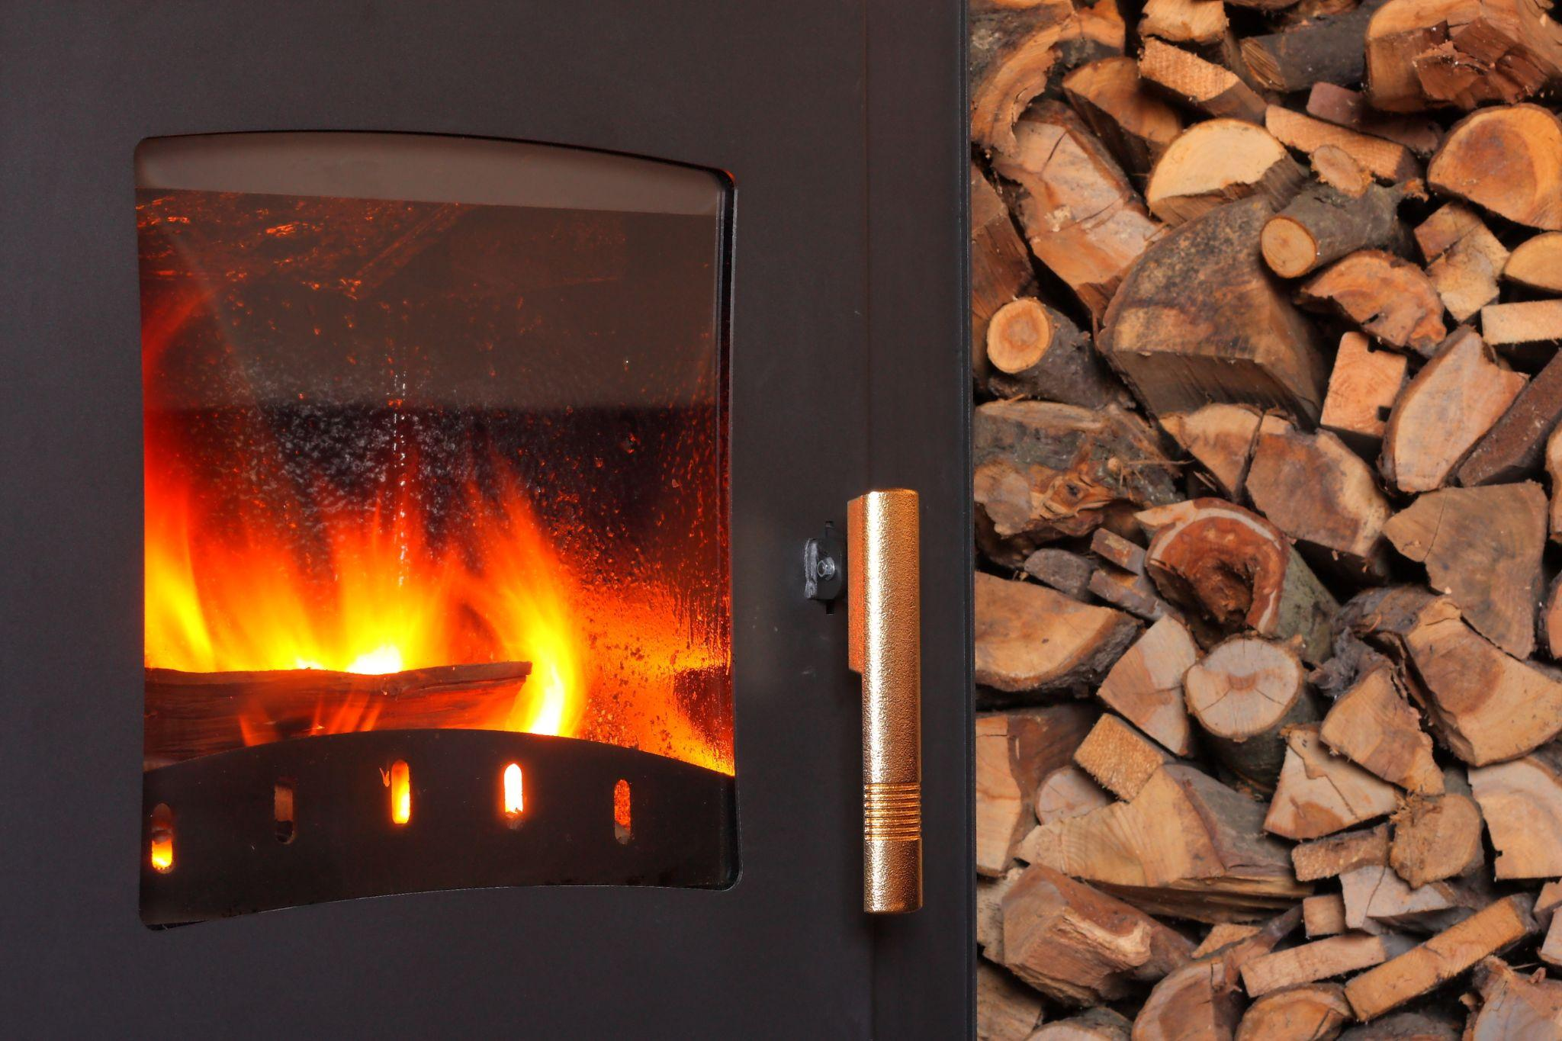
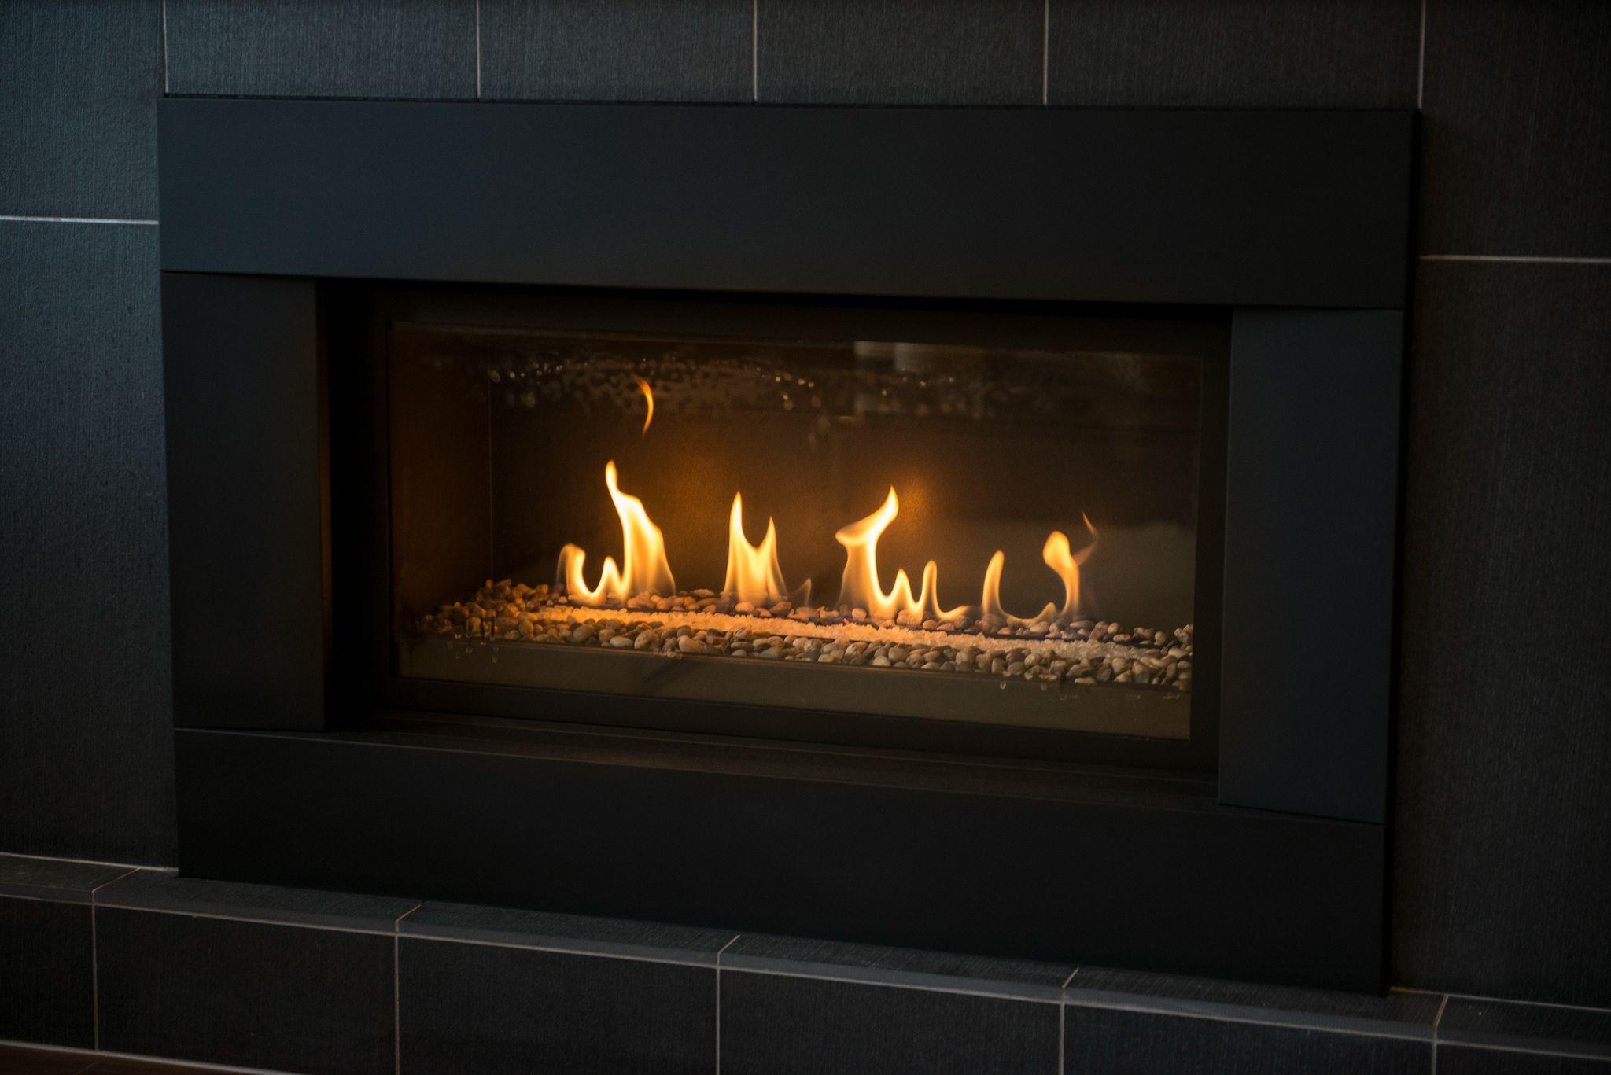
Exempted: Secondary heating equipment
The Zero Carbon Step Code regulates primary space-heating equipment. Secondary heating systems are exempted.
✔
✔
Wood-burning stoves OK
Decorative fossil-fuel fireplaces OK

